Slide 1


Photon color and photon wavelength …
Red light:
Photon energy = $1.8 eV$
$λ_{red}=7000 Å$
You can see here that red light is more stretched-out than blue light.
Blue light:
Photon energy = $3.6 eV$
$λ_{blue}=4000 Å$

Slide 2
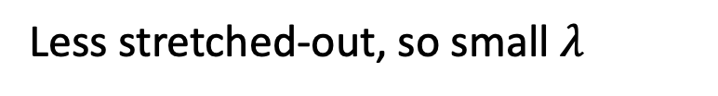

The wavelength of light (symbolized by $λ$)
-
More stretched-out, so big $λ$
Speed of light
-
Less stretched-out, so small $λ$

Slide 3
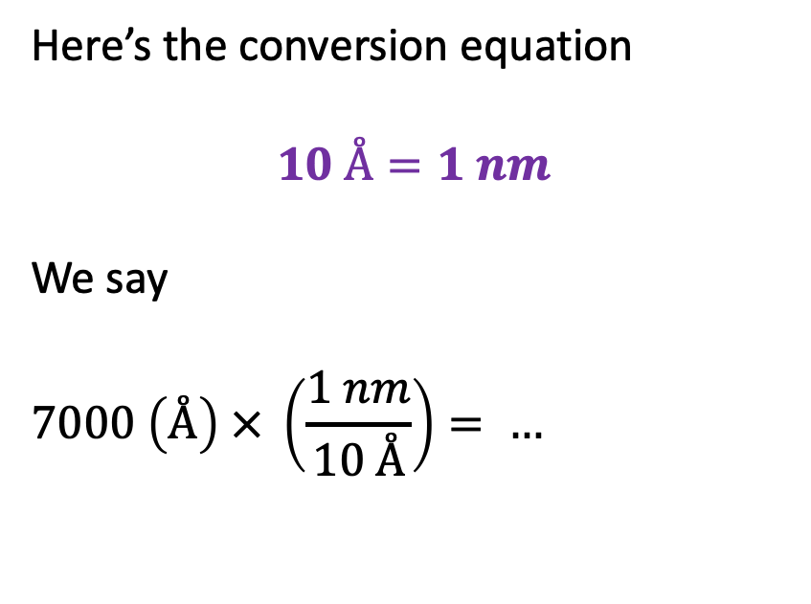
Unit conversions
Red light:
Photon energy = $1.8 eV$
$λ_{red}=7000 Å$
Here’s the conversion equation
$$10 Å=1 nm$$
We say
$$7000 \left(Å\right) × \left(\frac{1 nm}{10 Å}\right)= …$$
Blue light:
Photon energy = $3.6 eV$
$λ_{blue}=4000 Å$

Slide 4



Unit conversions
Red light:
Photon energy = $1.8 eV$
$λ_{red}=7000 Å$
Here’s the conversion equation
$$10 Å=1 nm$$
We say
$$7000 \left(Å\right) × \left(\frac{1 nm}{10 Å}\right)=700 (…)$$
Blue light:
Photon energy = $3.6 eV$
$λ_{blue}=4000 Å$

Slide 5
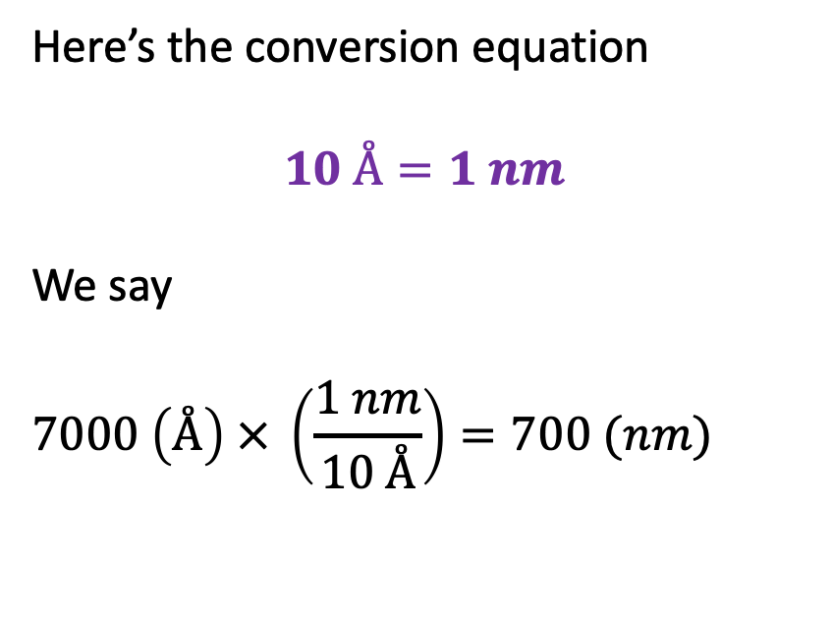
Unit conversions
Red light:
Photon energy = $1.8 eV$
$λ_{red}=7000 Å$
Here’s the conversion equation
$$10 Å=1 nm$$
We say
$$7000 \left(Å\right) × \left(\frac{1 nm}{10 Å}\right)=700 (nm)$$
Blue light:
Photon energy = $3.6 eV$
$λ_{blue}=4000 Å$

Slide 6
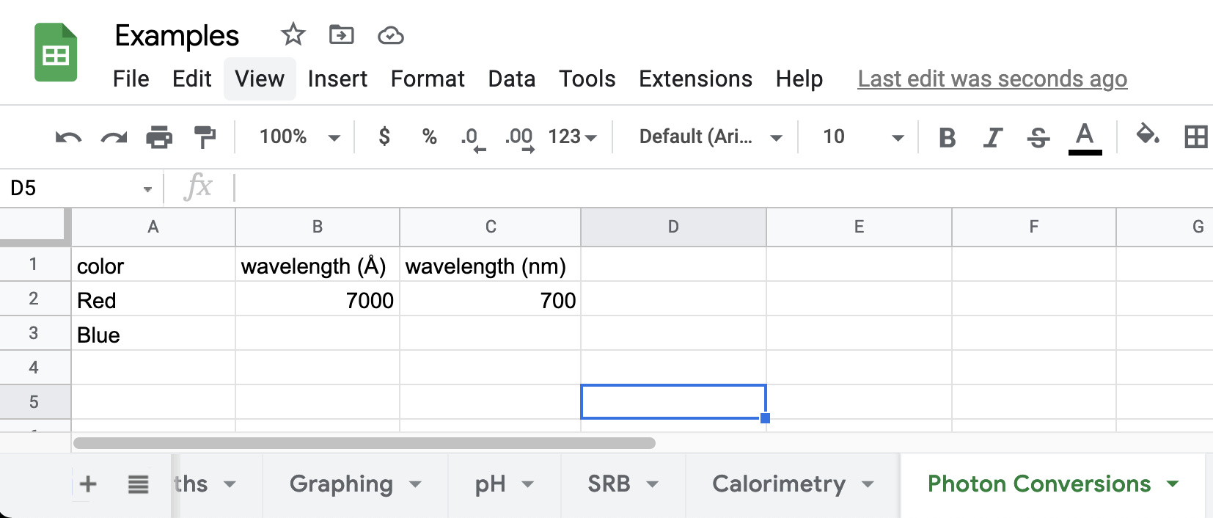
Unit conversions

Slide 7
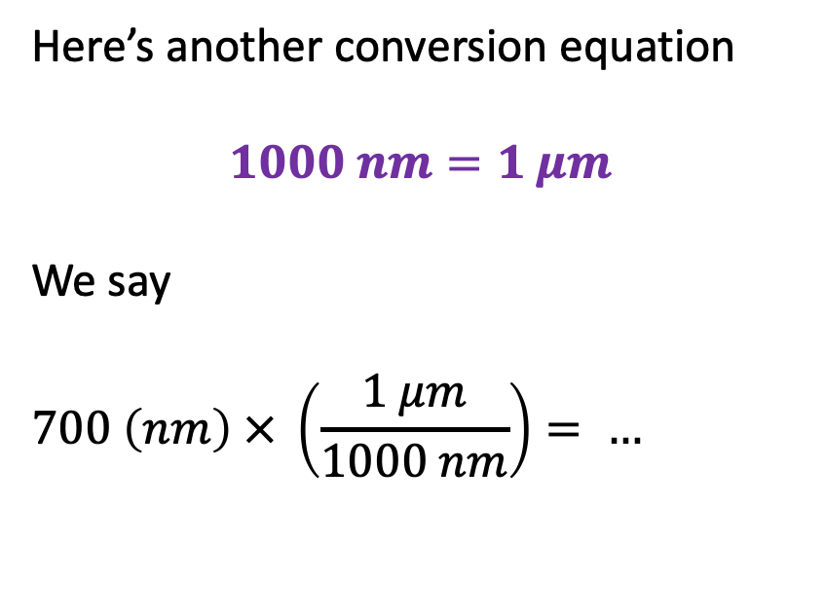
Unit conversions
Red light:
Photon energy = $1.8 eV$
$λ_{red}=7000 Å$
Here’s another conversion equation
$$1000 nm=1 μm$$
We say
$$700 \left(nm\right) × \left(\frac{1 μm}{1000 nm}\right)= …$$
Blue light:
Photon energy = $3.6 eV$
$λ_{blue}=4000 Å$

Slide 8

Unit conversions
Red light:
Photon energy = $1.8 eV$
$λ_{red}=7000 Å$
Here’s another conversion equation
$$1000 nm=1 μm$$
We say
$$700 \left(nm\right) × \left(\frac{1 μm}{1000 nm}\right)=0.7 (…)$$
Blue light:
Photon energy = $3.6 eV$
$λ_{blue}=4000 Å$

Slide 9
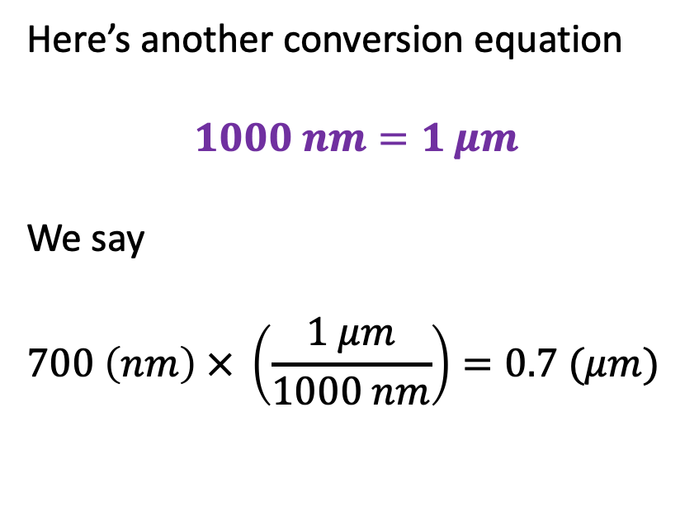
Unit conversions
Red light:
Photon energy = $1.8 eV$
$λ_{red}=7000 Å$
Here’s another conversion equation
$$1000 nm=1 μm$$
We say
$$700 \left(nm\right) × \left(\frac{1 μm}{1000 nm}\right)=0.7 (μm)$$
Blue light:
Photon energy = $3.6 eV$
$λ_{blue}=4000 Å$

Slide 10
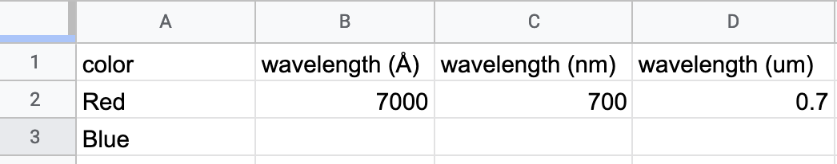
Unit conversions

Slide 11
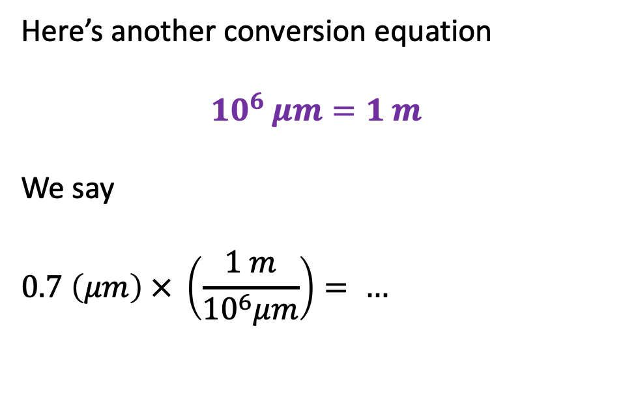
Unit conversions
Red light:
Photon energy = $1.8 eV$
$λ_{red}=7000 Å$
Here’s another conversion equation
$$10^{6} μm=1 m$$
We say
$$0.7 \left(μm\right) × \left(\frac{1 m}{{10}^{6}μm}\right)= …$$
Blue light:
Photon energy = $3.6 eV$
$λ_{blue}=4000 Å$

Slide 12
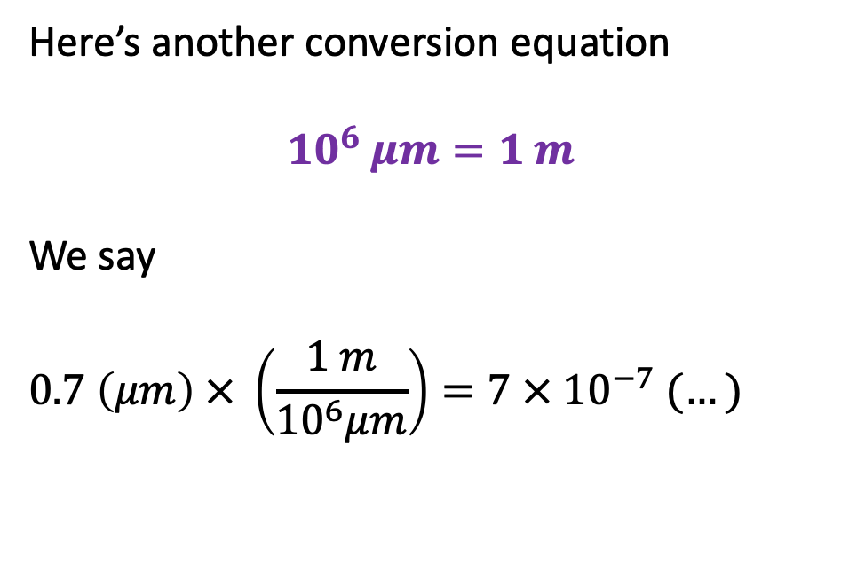
Unit conversions
Red light:
Photon energy = $1.8 eV$
$λ_{red}=7000 Å$
Here’s another conversion equation
$$10^{6} μm=1 m$$
We say
$$0.7 \left(μm\right) × \left(\frac{1 m}{{10}^{6}μm}\right)=7 × {10}^{−7} (…)$$
Blue light:
Photon energy = $3.6 eV$
$λ_{blue}=4000 Å$

Slide 13

Unit conversions
Red light:
Photon energy = $1.8 eV$
$λ_{red}=7000 Å$
Here’s another conversion equation
$$10^{6} μm=1 m$$
We say
$$0.7 \left(μm\right) × \left(\frac{1 m}{{10}^{6}μm}\right)=7 × {10}^{−7} (m)$$
Blue light:
Photon energy = $3.6 eV$
$λ_{blue}=4000 Å$

Slide 14
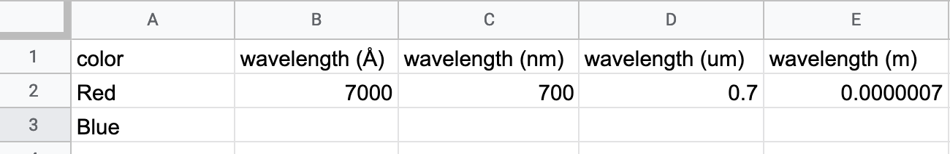

Unit conversions
$$10 Å=1 nm$$
$$1000 nm=1 μm$$
$$10^{6} μm=1 m$$

Slide 15
Qualitative relationship between wavelength and frequency
-
Big 𝝀, so peaks pass by less often
Speed of light
-
Small 𝝀, peaks pass by more often

Slide 16
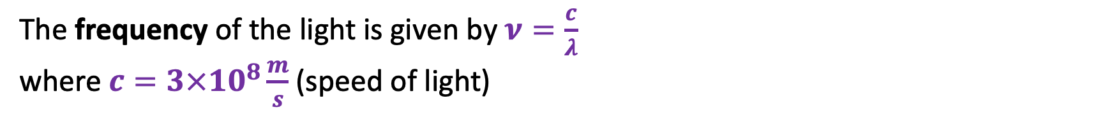
Quantitative relationship between wavelength and frequency
-
Big 𝝀, so peaks pass by less often
Speed of light
-
Small 𝝀, peaks pass by more often
The frequency of the light is given by $ν=\frac{c}{λ}$
where $c=3×10^{8}\frac{m}{s}$ (speed of light)

Slide 17
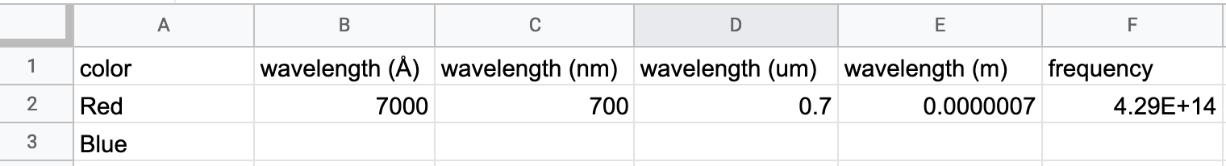
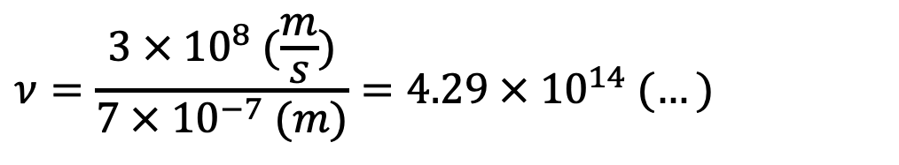
Practicing $ν=\frac{c}{λ}$
$$ν=\frac{3 × 10^{8} (\frac{m}{s})}{7 × 10^{−7} (m)}=4.29 × 10^{14} (…)$$

Slide 18
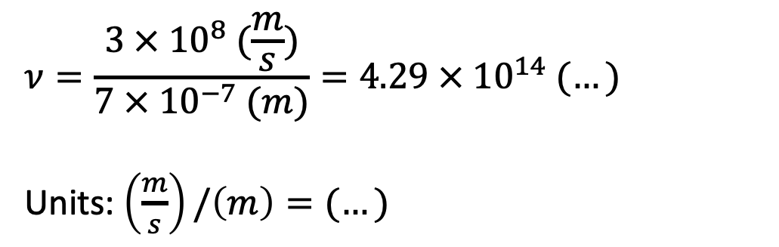
Practicing $ν=\frac{c}{λ}$
$$ν=\frac{3 × 10^{8} (\frac{m}{s})}{7 × 10^{−7} (m)}=4.29 × 10^{14} (…)$$
Units: $\left(\frac{m}{s}\right)/\left(m\right)=(…)$

Slide 19
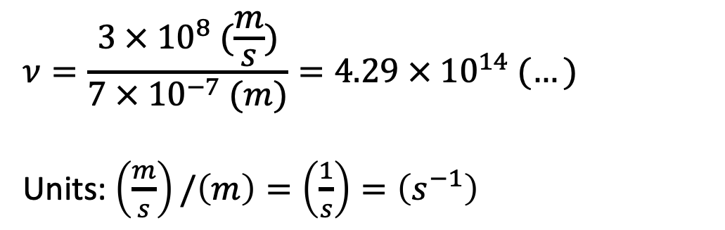
Practicing $ν=\frac{c}{λ}$
$$ν=\frac{3 × 10^{8} (\frac{m}{s})}{7 × 10^{−7} (m)}=4.29 × 10^{14} (…)$$
Units: $\left(\frac{m}{s}\right)/\left(m\right)=\left(\frac{1}{s}\right)=\left(s^{−1}\right)$

Slide 20
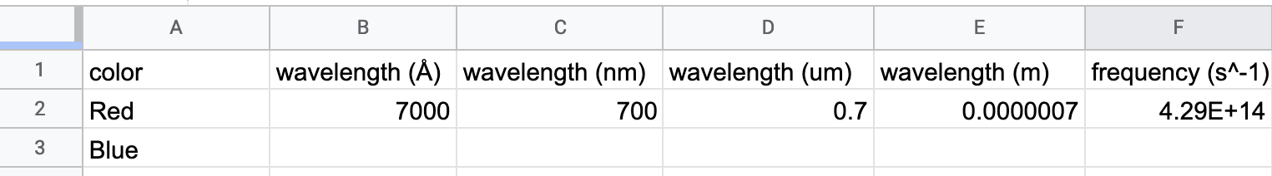
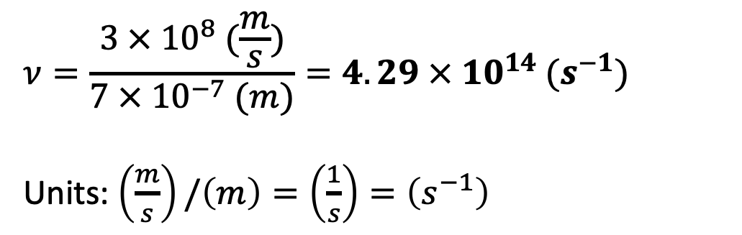
Practicing $ν=\frac{c}{λ}$
$$ν=\frac{3 × 10^{8} (\frac{m}{s})}{7 × 10^{−7} (m)}=4.29 × 10^{14} (s^{−1})$$
Units: $\left(\frac{m}{s}\right)/\left(m\right)=\left(\frac{1}{s}\right)=\left(s^{−1}\right)$

Slide 21
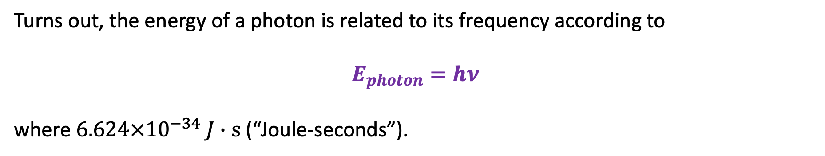
Getting a photon’s energy from the frequency of the light
Turns out, the energy of a photon is related to its frequency according to
$$E_{photon}=hν$$
where $6.624×{10}^{−34} J∙s$ (“Joule-seconds”).

Slide 22
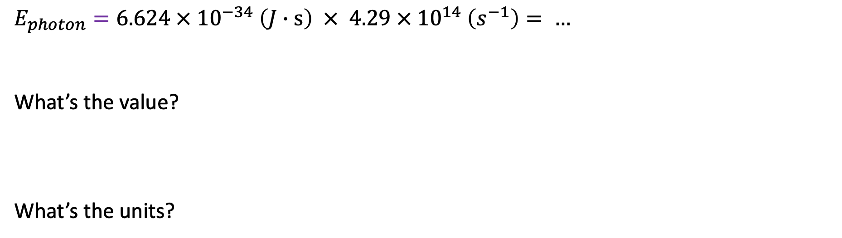
Practicing $E_{photon}=hν$
$$E_{photon}=6.624 × {10}^{−34} \left(J∙s\right) × 4.29 × {10}^{14} \left(s^{−1}\right)= …$$
What’s the value?
What’s the units?

Slide 23
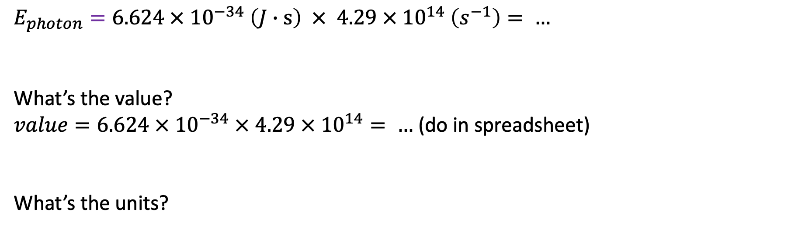
Practicing $E_{photon}=hν$
$$E_{photon}=6.624 × {10}^{−34} \left(J∙s\right) × 4.29 × {10}^{14} \left(s^{−1}\right)= …$$
What’s the value?
$value=6.624 × {10}^{−34} × 4.29 × {10}^{14}= …$ (do in spreadsheet)
What’s the units?

Slide 24
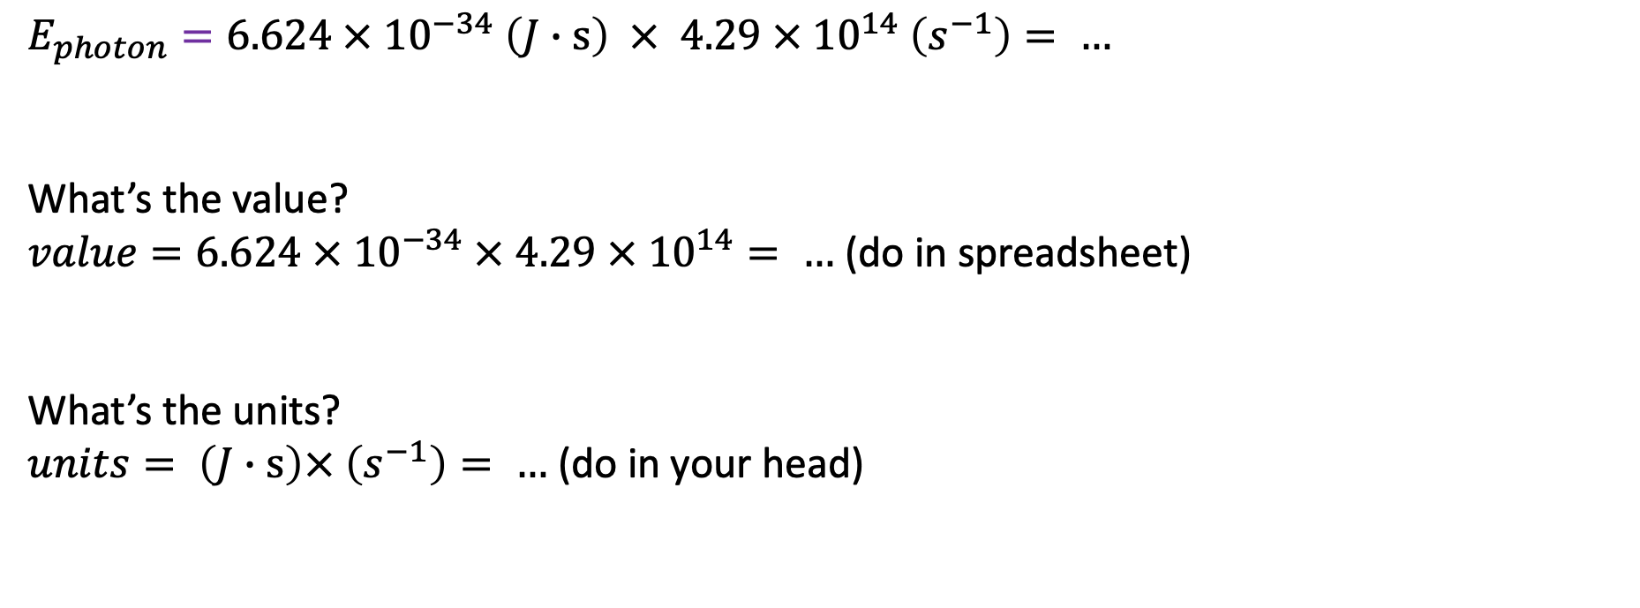
Practicing $E_{photon}=hν$
$$E_{photon}=6.624 × {10}^{−34} \left(J∙s\right) × 4.29 × {10}^{14} \left(s^{−1}\right)= …$$
What’s the value?
$value=6.624 × {10}^{−34} × 4.29 × {10}^{14}= …$ (do in spreadsheet)
What’s the units?
$units= \left(J∙s\right)× \left(s^{−1}\right)= …$ (do in your head)

Slide 25
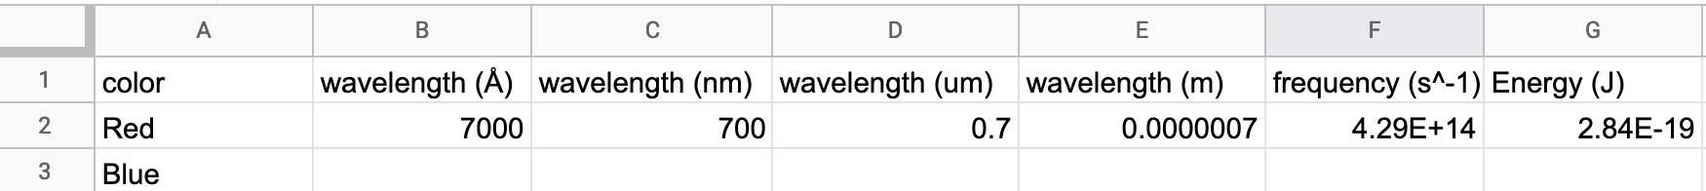
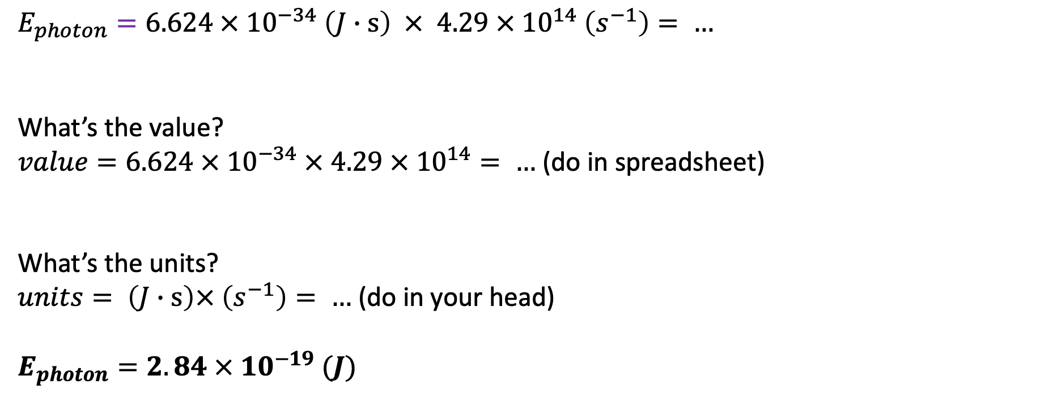
Practicing $E_{photon}=hν$
$$E_{photon}=6.624 × {10}^{−34} \left(J∙s\right) × 4.29 × {10}^{14} \left(s^{−1}\right)= …$$
What’s the value?
$value=6.624 × {10}^{−34} × 4.29 × {10}^{14}= …$ (do in spreadsheet)
What’s the units?
$units= \left(J∙s\right)× \left(s^{−1}\right)= …$ (do in your head)
$E_{photon}=2.84 × {10}^{−19} (J)$

Slide 26
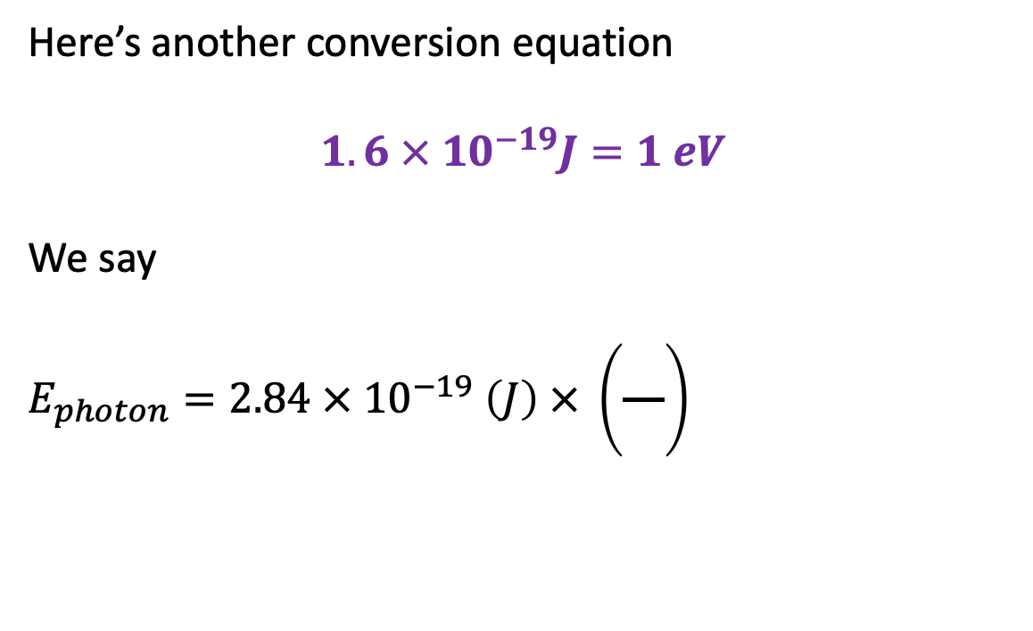


Converting photon energy from J to eV
Here’s another conversion equation
$$1.6 × 10^{−19}J=1 eV$$
We say
$$E_{photon}=2.84 × {10}^{−19} \left(J\right) × \left(\frac{}{}\right)$$
Red light:
Photon energy = $1.8 eV$
$λ_{red}=7000 Å$
Blue light:
Photon energy = $3.6 eV$
$λ_{blue}=4000 Å$

Slide 27
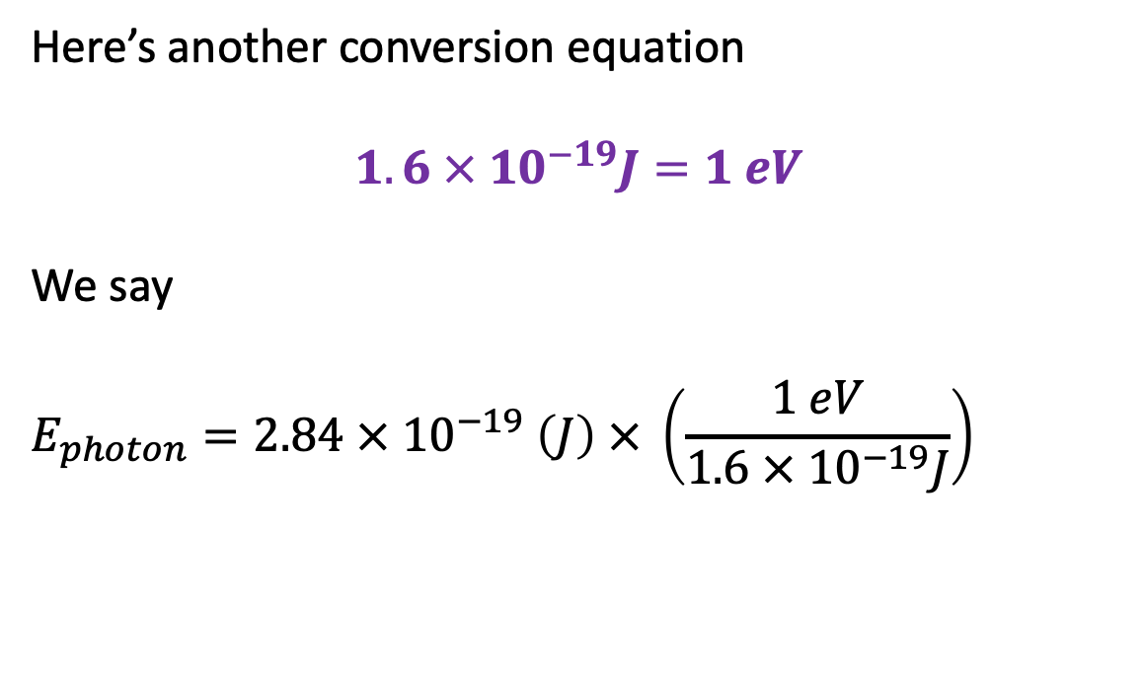
Converting photon energy from J to eV
Here’s another conversion equation
$$1.6 × 10^{−19}J=1 eV$$
We say
$$E_{photon}=2.84 × {10}^{−19} \left(J\right) × \left(\frac{1 eV}{1.6 × {10}^{−19}J}\right)$$
Red light:
Photon energy = $1.8 eV$
$λ_{red}=7000 Å$
Blue light:
Photon energy = $3.6 eV$
$λ_{blue}=4000 Å$

Slide 28
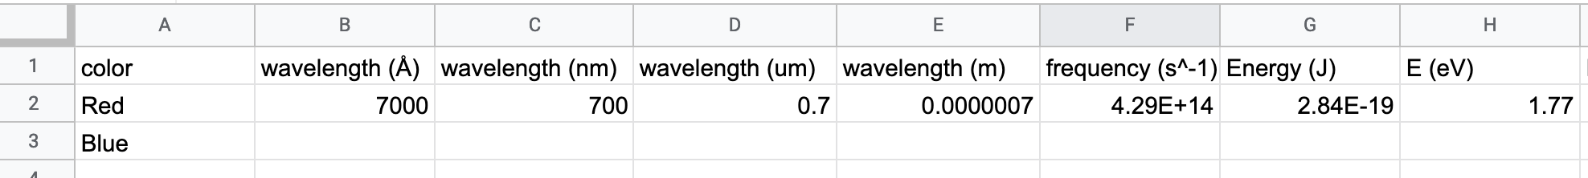
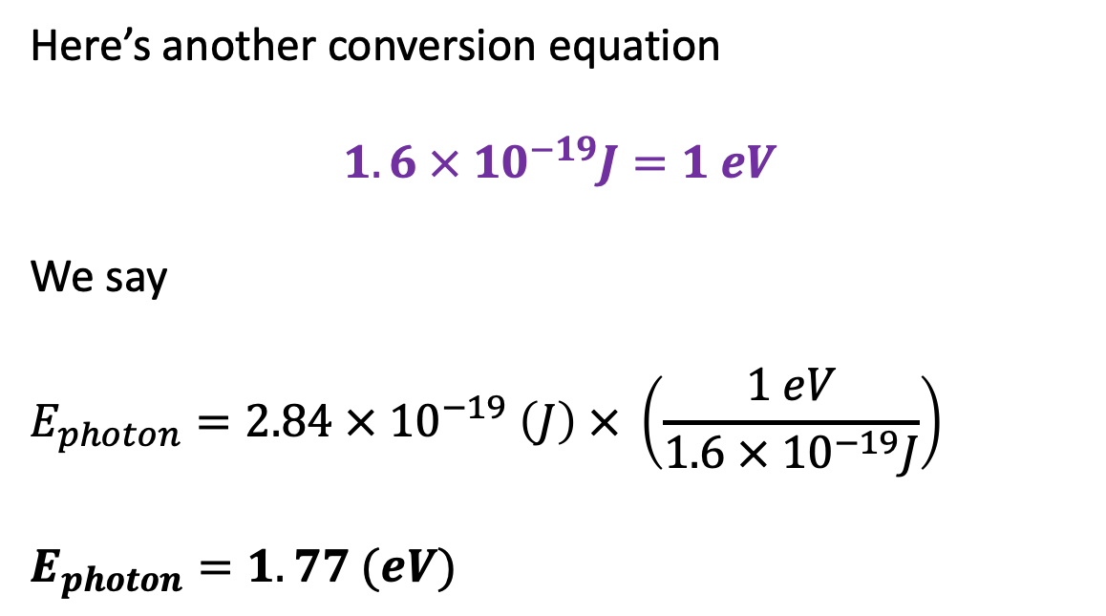
Converting photon energy from J to eV
Here’s another conversion equation
$$1.6 × 10^{−19}J=1 eV$$
We say
$$E_{photon}=2.84 × {10}^{−19} \left(J\right) × \left(\frac{1 eV}{1.6 × {10}^{−19}J}\right)$$
$E_{photon}=1.77 (eV)$
Red light:
Photon energy = $1.8 eV$
$λ_{red}=7000 Å$
Blue light:
Photon energy = $3.6 eV$
$λ_{blue}=4000 Å$

Slide 29
Practice: working your way back …

